Slide 1

Tractortek capstone
TractorTEK – time to get down and dirty!
Presented by: Monique Brown
May 18th, 2022

Slide 2
Capstone 1 Instructions
Student guide for planning your presentation
Suggested order of components to demo:
Web App UI – Data Entry Functionality​
Sales Dashboard, and Analysis Findings​
Back end – Database Design​
Focal points should be: ​
Design choices & justifications​
Value to the customer
Slides & flow
Title Slide
One slide with the name of your solution, a few screenshots, and your picture
Use this slide to very briefly introduce your app, providing a summary of how it works.
[Live Demo]
Appendix
Any supporting materials such as diagrams, that you may refer to during Q&A

Slide 3

What’s the problem?
TractorTEK had their sales tracking system crash and was left with only back-up data. We’re tasked with establishing a user-friendly web UI used by their team leads for entry of weekly sales data and re-establishing a database for storing data!

Slide 4
Introducing Mo-Simple Solutions
New TractorTEK Web UI

Slide 5
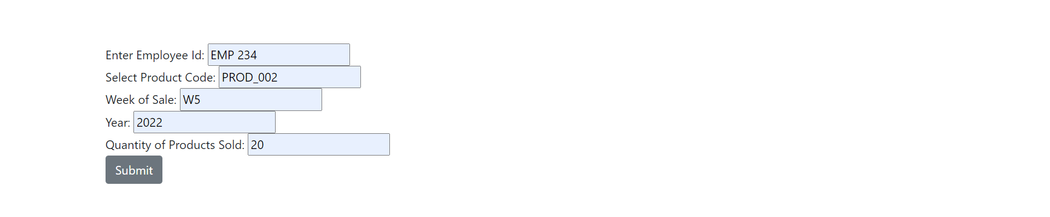
Web UI Layout and Functionality
Why so simple?
Simple and clean web UI A simple and clean web UI layout decreases confusion for team leads on how to navigate the site and provides TractorTEK a foundation to build off. They can choose to further enhance the website in the future or keep the simple layout as is
Easy to understand data entry forms The clear data entry forms makes for simple weekly sales entry making sure that the team lead has all information needed to upload to the database

Slide 6
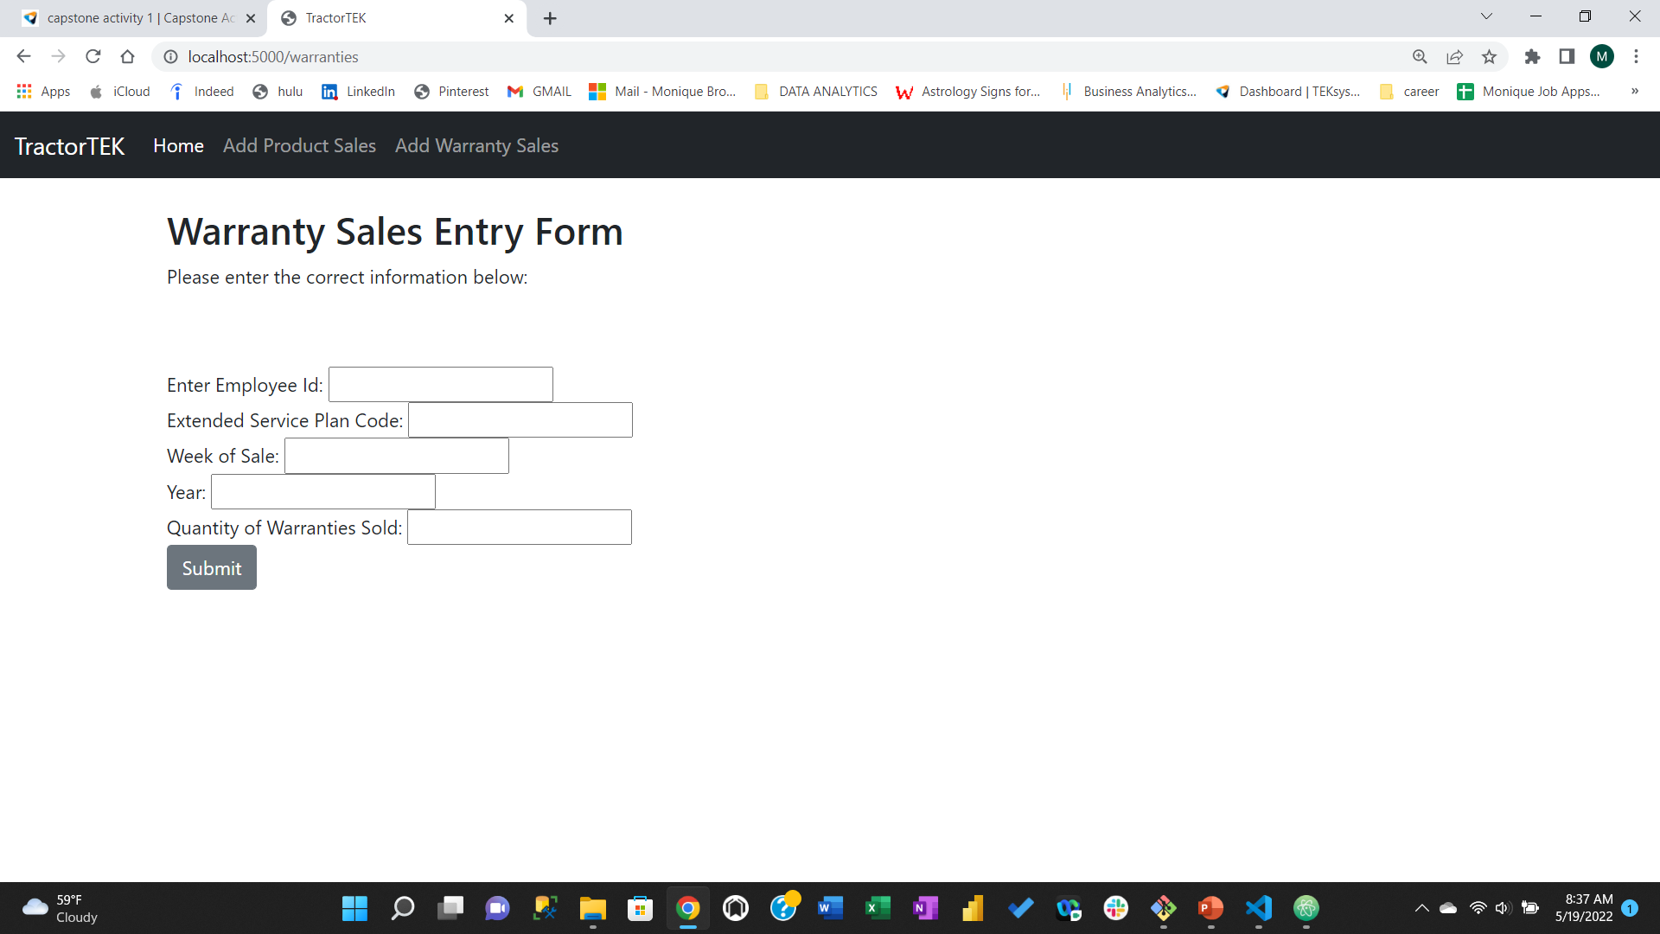

Web UI Layout and Functionality
Why so simple?

Slide 7
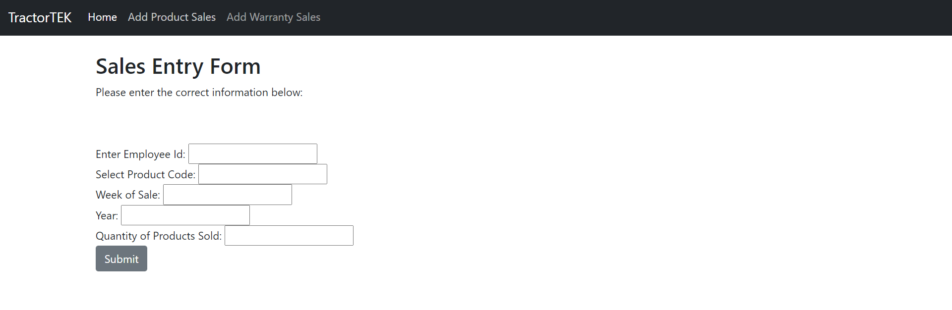
Web UI Layout and Functionality
Why so simple?

Slide 8
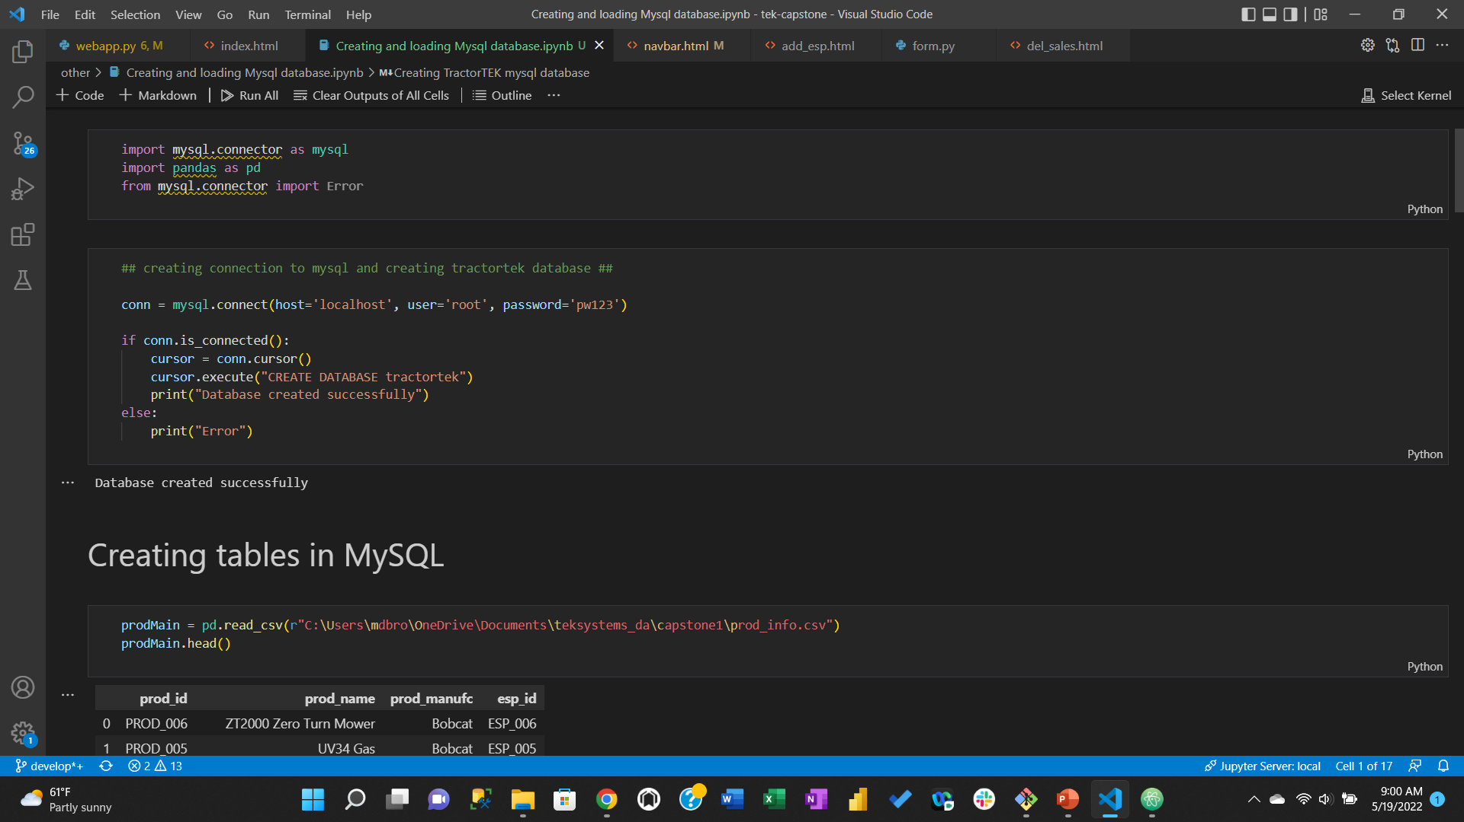
How the new database was created …

Slide 9
The End
Thank you!

